Slide 1
Drowsy Driving Detection and Alert System

Slide 2
GROUP MEMEBERS
Sachin Chaudhary - 0792544
Dhruvin KetanKumar Raval - 0787447
Parth Bhavinkumar Brahmbhatt - 0793999
Ruchit Alpeshbhai Patel - 0789968
Ritik Rajeshbhai Patel - 0801738

Slide 3





CONTENTS
Problem Statement
Problem Importance
Problem Solution
Product Architecture
Database Architecture
Webapp Snapshots
References

Slide 4
Problem Statement
Drowsy driving is feeling sleepy while operating a vehicle. This usually happens when a driver has not slept enough, had alcohol, is under certain medications or has sleep disorders. Research has found that meals that are high in fat, carbohydrates, or calories may increase sleepiness
No one knows the exact moment when sleep will come over their body. Falling asleep at the wheel is clearly dangerous, but being sleepy also affects your ability to drive safely, even if you do not fall asleep. Drowsiness may:
Makes you less attentive to surroundings.
Slows your reaction time if need to steer suddenly or stop and Worsen decision making.
Vision and depth perception: Along with slower reaction times, your vision can get blurry and sensitive to light when you are tired. It may be harder to tell how far away other cars are from you.

Slide 5
PROBLEM Importance
Drowsy driving is a major contributor to motor vehicle collisions. In a CDC survey, an estimated 1 in 25 adult drivers reported having fallen asleep while driving in the previous 30 days.
According to the National Highway Traffic Safety Administration (NHTSA), in 2017 drowsy driving led to at least 91,000 crashes, resulting in roughly 50,000 injuries and 800 deaths. In 2020, there were 633 deaths based on police reports.
However, these numbers are underestimated, and over 6,000 fatal crashes each year may involve a drowsy driver.

Slide 6
Problem Solution
We are developing a safety product to identify the driver, capture car details, location and detect microsleep.
The details will be stored in RDBMS database and once the microsleep is detected the system will generate notification and send the alter to driver.
Analytics will be performed on the data to extract insights on microsleep patterns with respect to factors like time, location, driver.
This product will help rideshare or vehicle rental companies to identify the sleep deprived drivers and can prevent the fatal accidents before it happens. Alert and notifications will allow them to track the driver details and location and time where the incident happened.

Slide 7

Product Architecture

Slide 8







User Registration
User
Capture details
User Authentication
Location capture
Authentication Successful
Trip started
Access Denied
Initiate driver drowsiness monitor process
Location capture

Slide 9
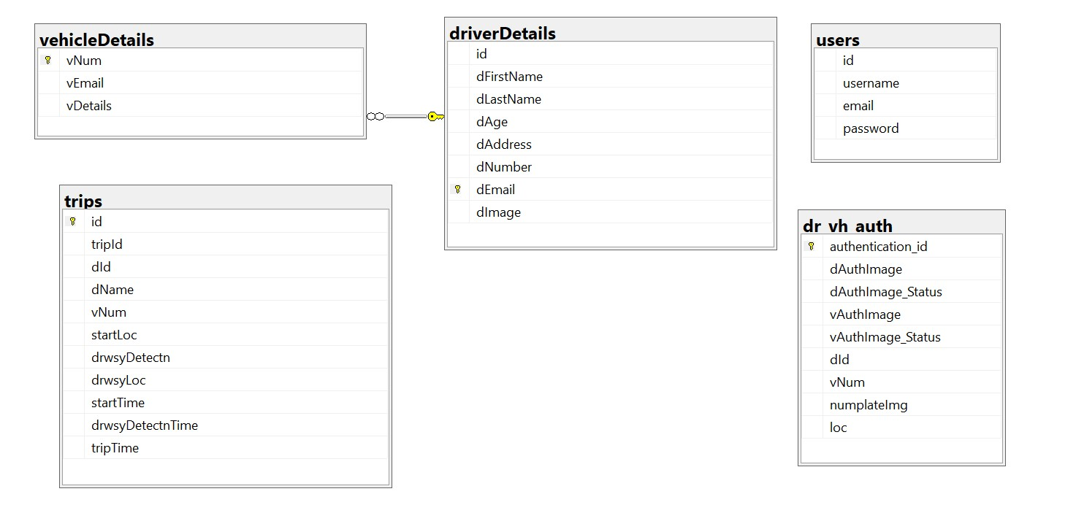
Database architecture

Slide 10
WebApp Flow

Slide 11
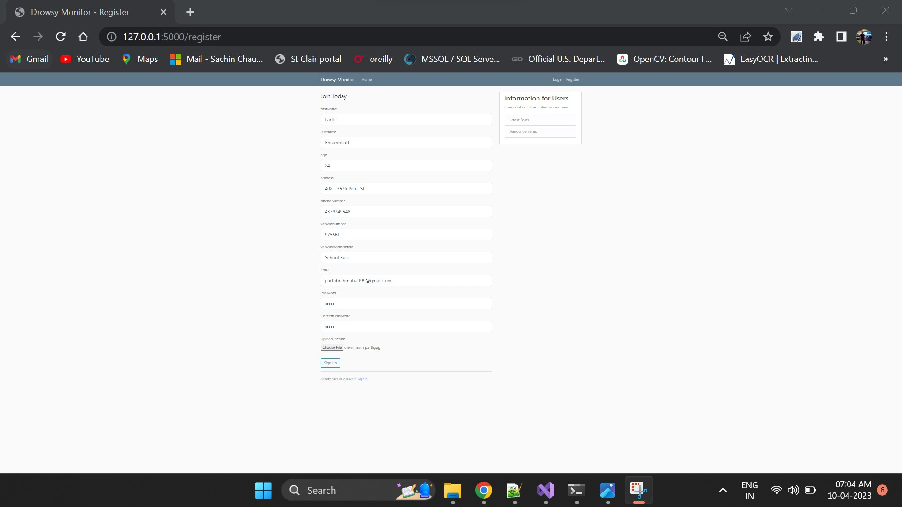
Registration Page

Slide 12
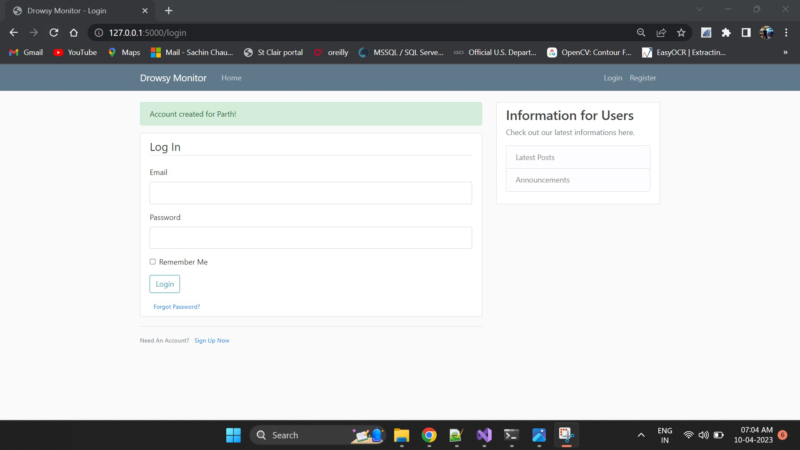
Login Page

Slide 13
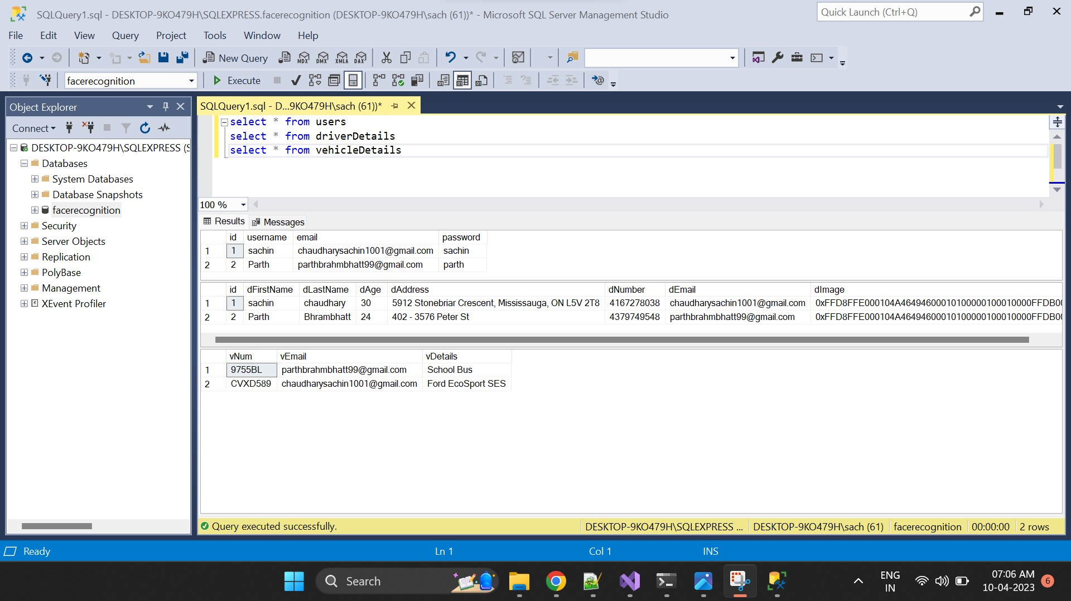
Data Recorded for Newly registered Users

Slide 14
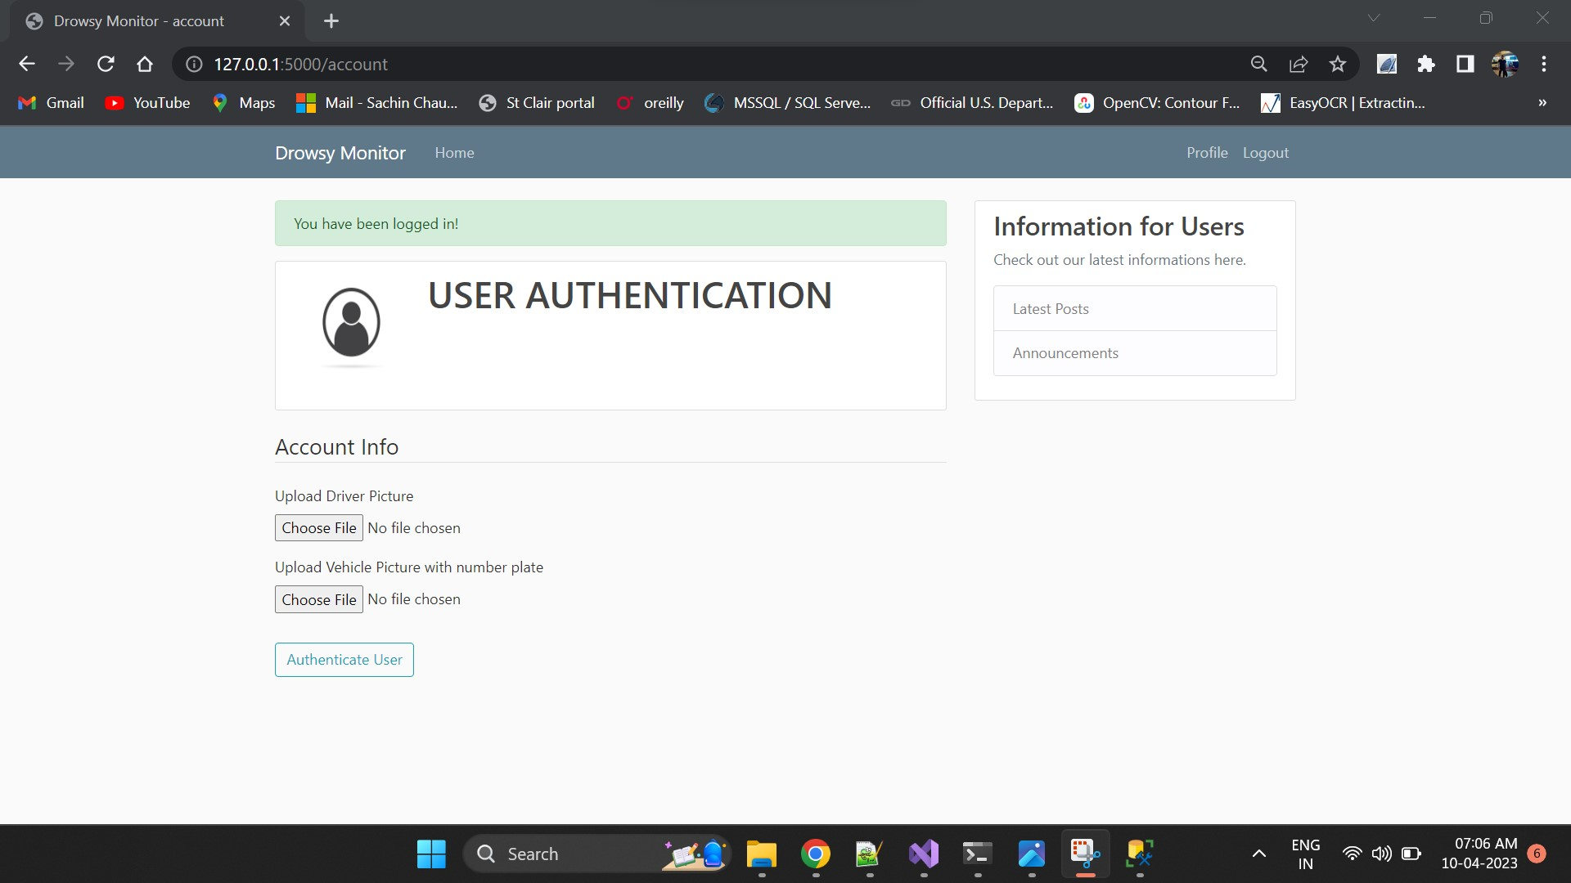
User Authenticated

Slide 15

Adding Image of driver and vehicle plate

Slide 16
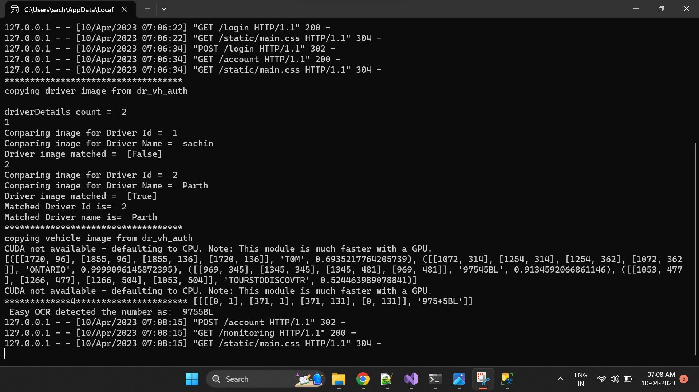
User image and plate gets matched

Slide 17
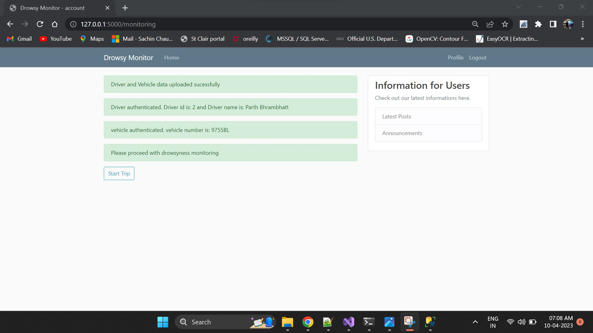
Trip start

Slide 18
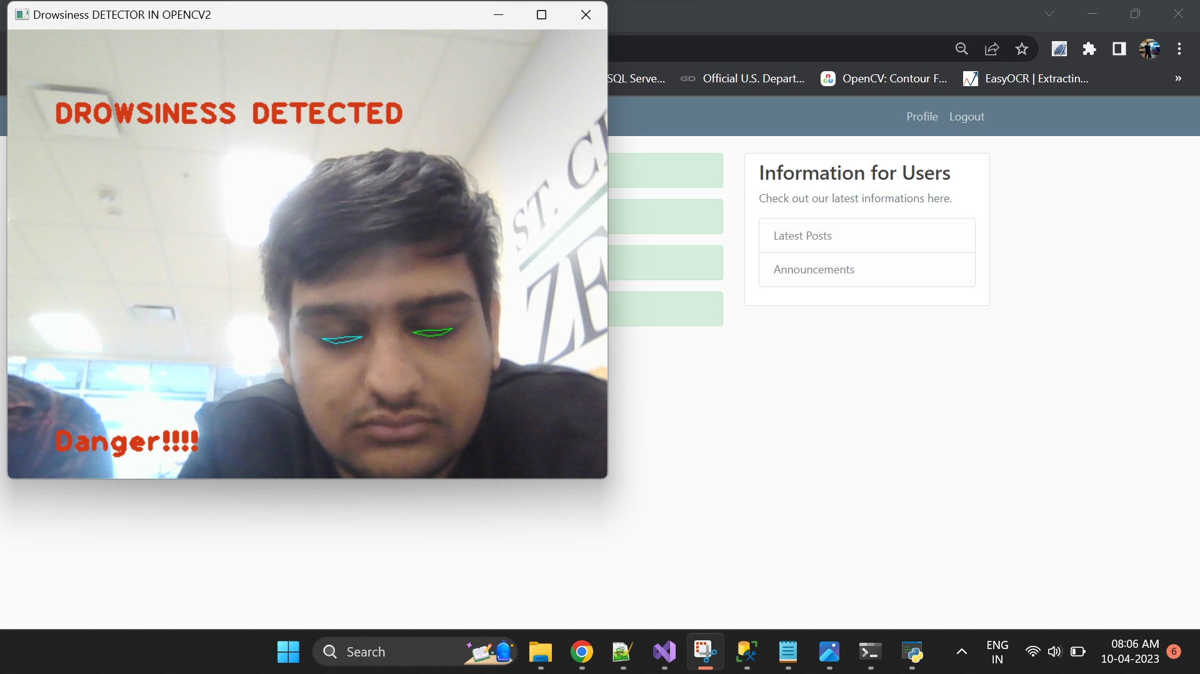
Drowsiness detected

Slide 19
https://www.sleepfoundation.org/drowsy-driving
https://docs.opencv.org/3.4/d2/d42/tutorial_face_landmark_detection_in_an_image.html
https://www.cdc.gov/sleep/features/drowsy-driving.html
References

Slide 20
Thank you

